Slide 1
UML to Java Code Generator

Slide 2
Basic
Input: XMI File from ArgoUML
Output: Java Code
XMI File
Validate
Generate Code

Slide 3
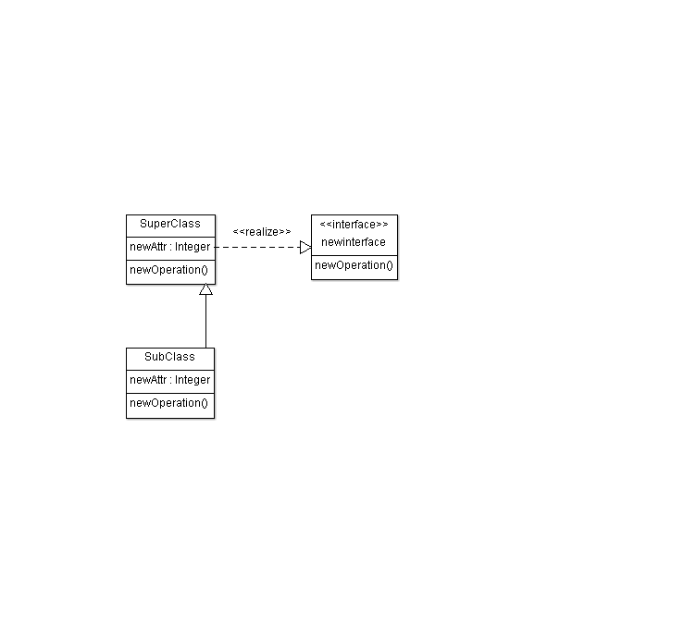
Example Class Diagram

Slide 4
Operations on main screen
Validate file
Generate code

Slide 5
Validation
Keywords from the XMI file
  XMI Exporter
  xmi version

Slide 6
Code Generation
Keywords
  Class
  Attribute
  Operation
  Generalization
  DataType

